Slide 1
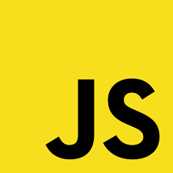
How Javascript works

Slide 2
function A(){ console.log("A"); B(); } function B(){ console.log("B"); C(); } function C(){ console.log("C"); } A();
Execution Stack
Console
C()
A
B()
B
A()
C
Main()

Slide 3
function A(){ console.log("A"); A(); } A();
Execution Stack
A()
A()
A()
A()
maximum stack size exceeded
A()
Console
A()
A
A
A
A()
A
A
A
A
Main()

Slide 4
console.log('Hello Devs'); setTimeout(()=>{ console.log('Hello After 5000ms'); },5000) console.log('Hello Devs Again');
Execution Stack
console.log('Hello Devs Again');
console.log('Hello Devs After 5000ms ');
Console
Hello Devs
setTimeout()
Hello After 5000ms
console.log('Hello Devs');
Hello Devs Again
Main()

Slide 5
console.log('Hello'); setTimeout(()=>{ console.log('Hello After 5000ms'); },5000) console.log('Hello2');
WebApis
setTimeOut(5000);
Execution Stack
Event Loop
Event Queue
Console
setTimeOut();
Hello
log('Hello2');
log(‘hello after 5000ms’);
hello2
setTimeOut();
setTimeOut(5000);
Hello afater 500ms
Main()

